Slide 1

Exploring the Foundation of Life in the Universe with Ultrafast Dynamics
Hailey Nelson
Scott Sayres, Chase Rotteger, Hannah Rucker
Arizona State University, School of Molecular Sciences
Arizona Space Grant Symposium, April 19, 2025

Slide 2
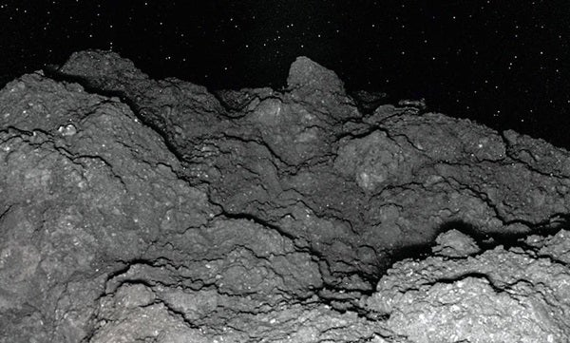
Organic Molecules and Asteroids
20,000 organic molecules were found on the asteroid Ryugu, including amino acids (the base material for proteins)
All are also found on Earth naturally!
We know amino acids exist on asteroids… and we know we have complex life made of amino acids on Earth… but what are the steps between them?
Credit: Ireland 2023- “Asteroid Ryugu samples found to contain uracil, a key component of RNA"
Hailey Nelson, henelso3@asu.edu

Slide 3
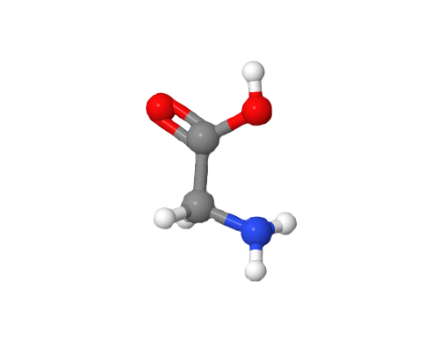
Purpose
Amino Acids are the building blocks of life
Life may have started when they crashed onto Earth aboard meteorites
Study how amino acids bond with each other to form peptide bonds and form proteins
Possibility to uncover the origin of life!
Hailey Nelson, henelso3@asu.edu

Slide 4
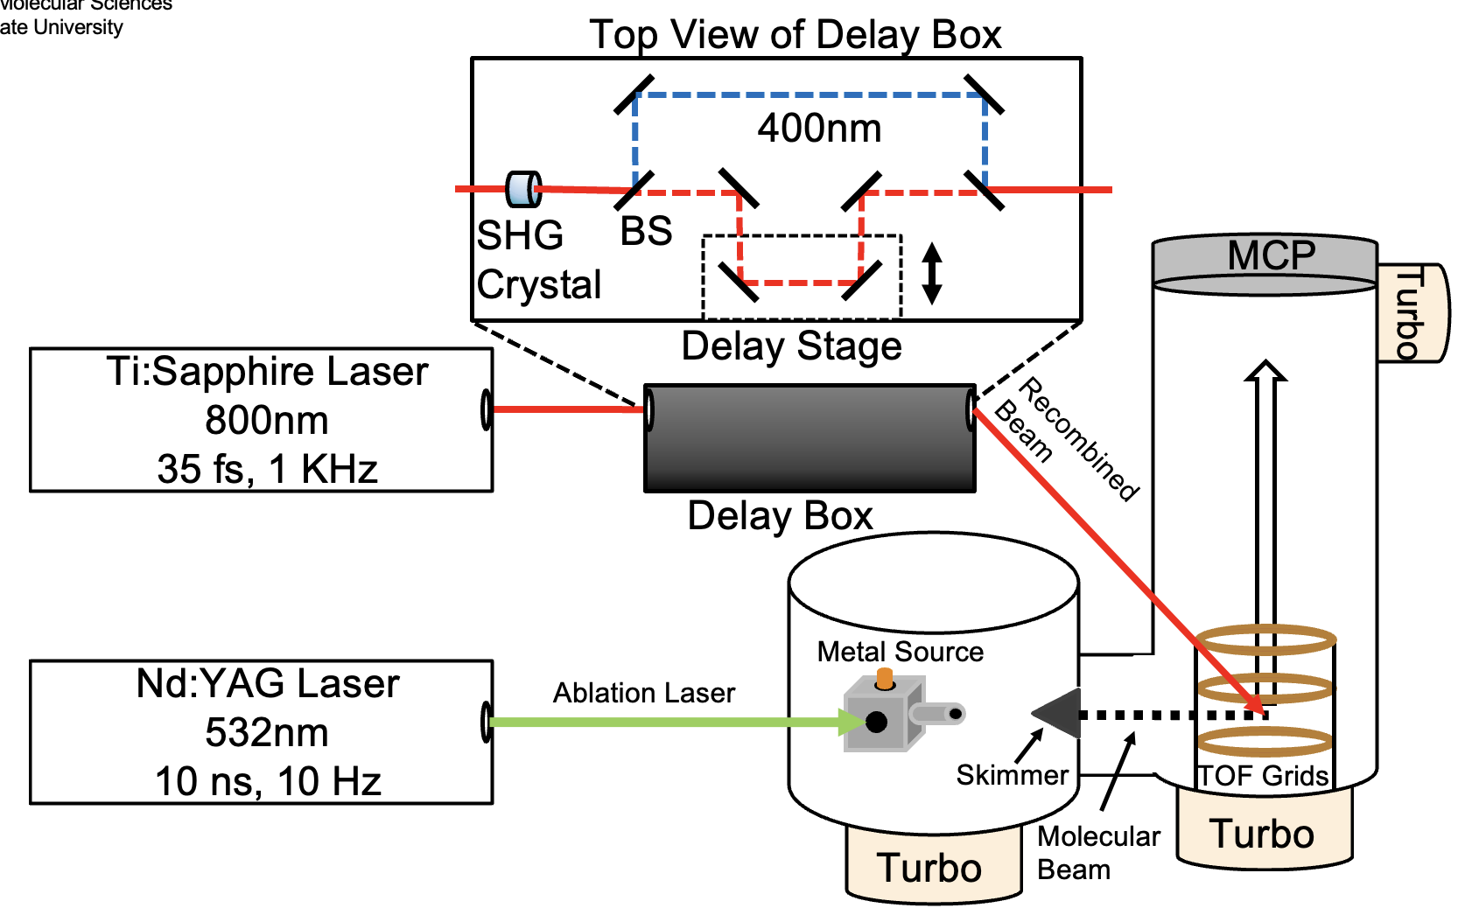
Instrumentation
Measures excited-state dynamics
Pump-Probe Spectroscopy
Femtosecond Laser
Time-of-flight mass spectrometer
Hailey Nelson, henelso3@asu.edu

Slide 5
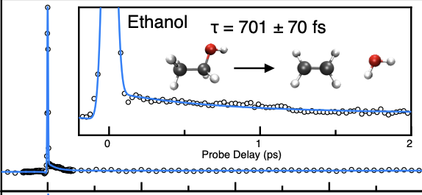
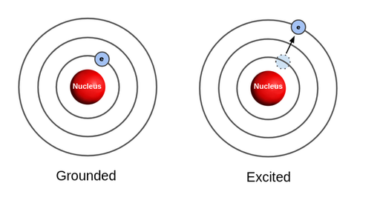
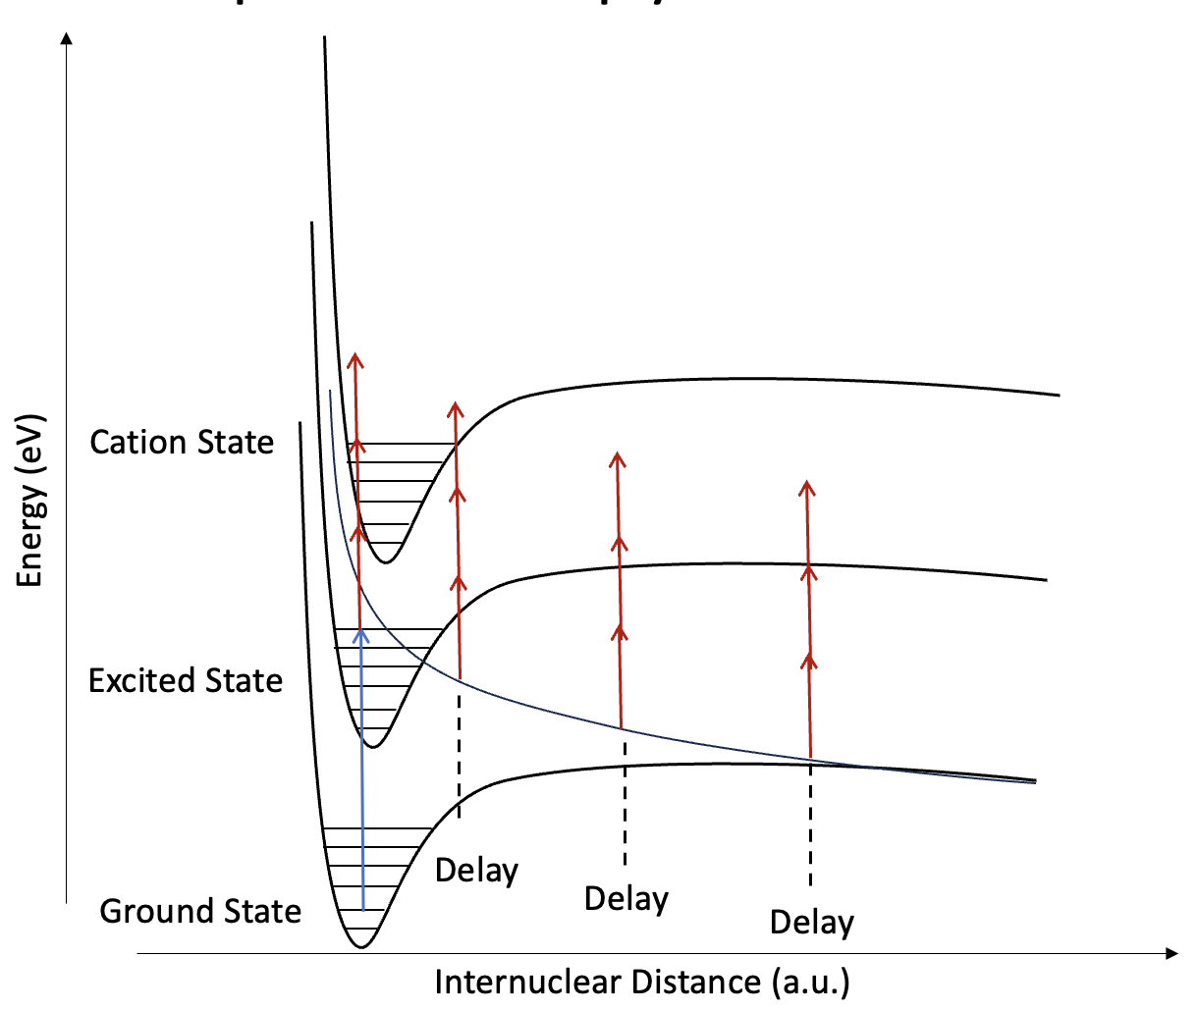
The Excited State
Laser hits sample (Time Zero)
Relaxation
The laser excites the sample’s electrons
As the electrons relax back to the ground state, we take measurements
Measurement
Hailey Nelson, henelso3@asu.edu

Slide 6
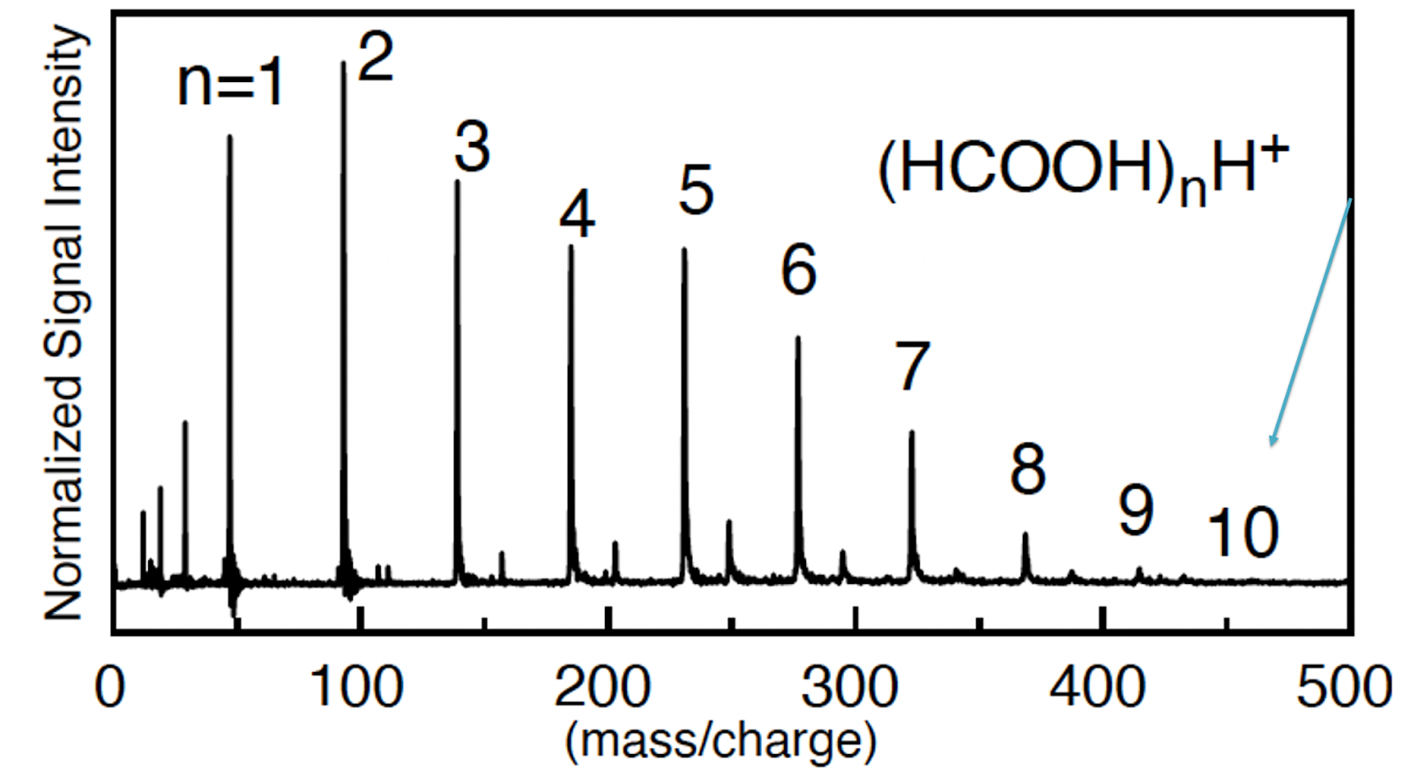
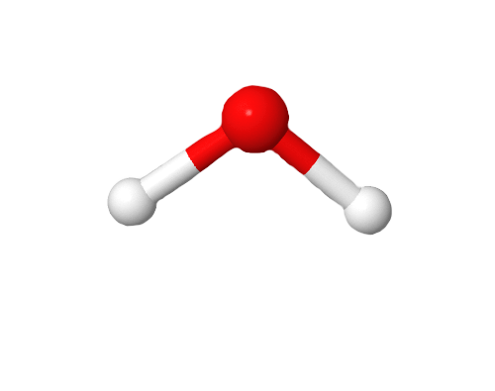
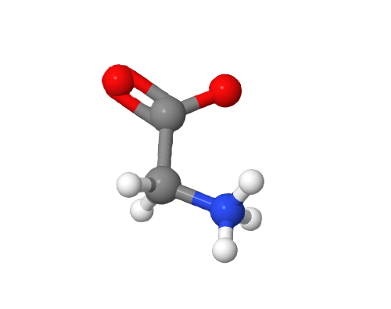
Amino Acids
Unknown Number of Water Molecules
- Water molecules
allow for charge
separation, which
allows amino acids to
bond with each other
and make complex
structures!
- But… how many water molecules are needed?
- Mass spectra let us determine the exact number
of water molecules needed for the transition
Neutral Glycine
?
Example Mass Spectrum of Formic Acid clusters, showing the distinct separation between cluster groups.
Charge-Separated Glycine
Hailey Nelson, henelso3@asu.edu

Slide 7
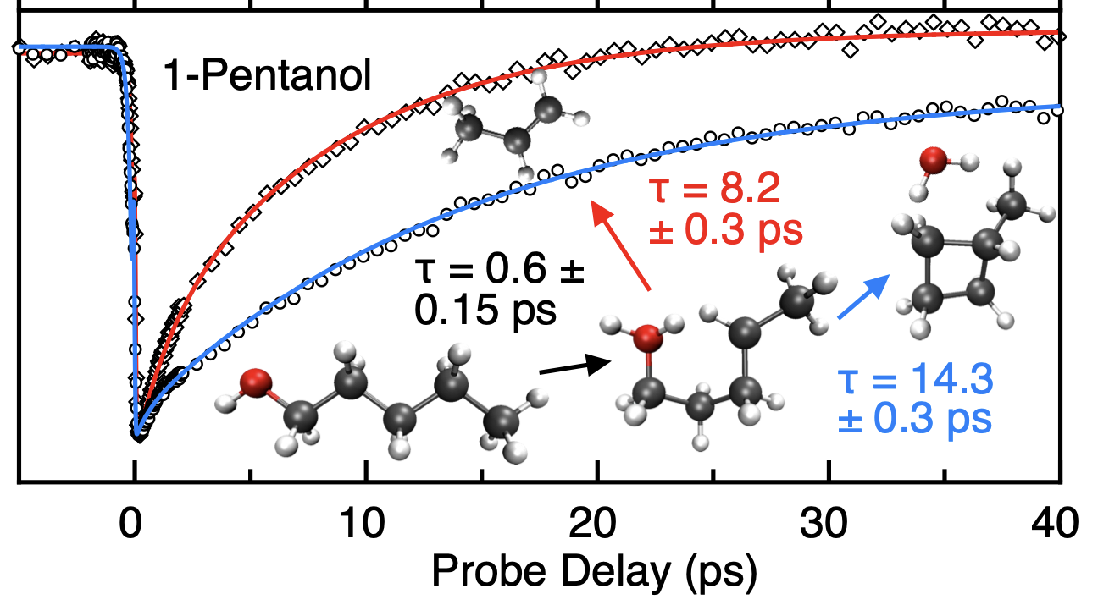
Preliminary Results and Expected Outcomes
One and two step processes observable
Proton transfers and water loss observable
Couple with a mass spectrum to determine
the number of water
molecules needed for
transition
Hailey Nelson, henelso3@asu.edu

Slide 8
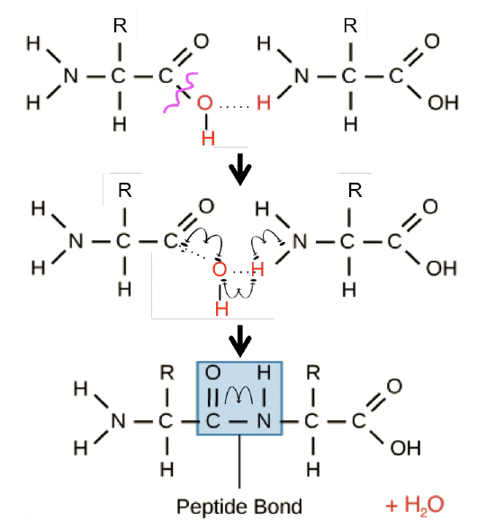
Expected Outcomes
Proposed two step process similar to 1-Pentanol
Step One: Bond breakage (short duration)
Step Two: Water loss and
rearrangement (long duration)
Final Product: Two bonded amino
acids… 20 make a protein!
Amino Acid #1
Amino Acid #2
Hailey Nelson, henelso3@asu.edu

Slide 9

Summary
Evaluating how to form peptide bonds between amino acids through laser excitation.
A two-step mechanism is proposed involving a bond breakage then water loss and rearrangement.
The overarching goal is to understand how peptide bonds can form through UV and IR excitation in space like conditions.
Thank you!
Special thanks to Dr. Scott Sayres, Chase Rotteger, Hannah Rucker, Arizona State University, and ASU/NASA Space Grant for making this project possible.
LinkedIn
Hailey Nelson, henelso3@asu.edu

